Slide 1

Supervised Learning
André Sousa (up202005277@fe.up.pt)
Gonçalo Pinto (up202004907@fe.up.pt)
Pedro Fonseca (up202008307@fe.up.pt)
AI Second Project

Slide 2
Specification of the work
Goal: Analyze and study the process of classification (data preprocessing, feature selection, model selection, model training and model evaluation). In this case, the goal is to use data collected from past records of an insurance company to predict whether a given client will file a claim in the next 6 months.
Project Objectives:
Given a data set, predict the target feature
Compare multiple machine learning models and feature selection to achieve the best results

Slide 3
Software used and related work
Stuart Russell, Peter Norvig; Artificial intelligence. ISBN: 978-0-13-207148-2
Richard S. Sutton; Reinforcement learning. ISBN: 978-0-262-03924-6
Stuart Russel, Peter Norvig; Artificial Intelligence: A modern Approach.
Exercise5 IART SupervisedLearning
Other approaches to the problem

Slide 4
Tools and algorithms
PyCharm Professional
Python 3.9
Git
Python packages:
scikit-learn
Pandas
Seaborn
Matplotlib
Machine Learning models:
Decision Tree
Neural Network (MLP)
k-nearest neighbors (KNN)
Support Vector Machine (SVM)

Slide 5
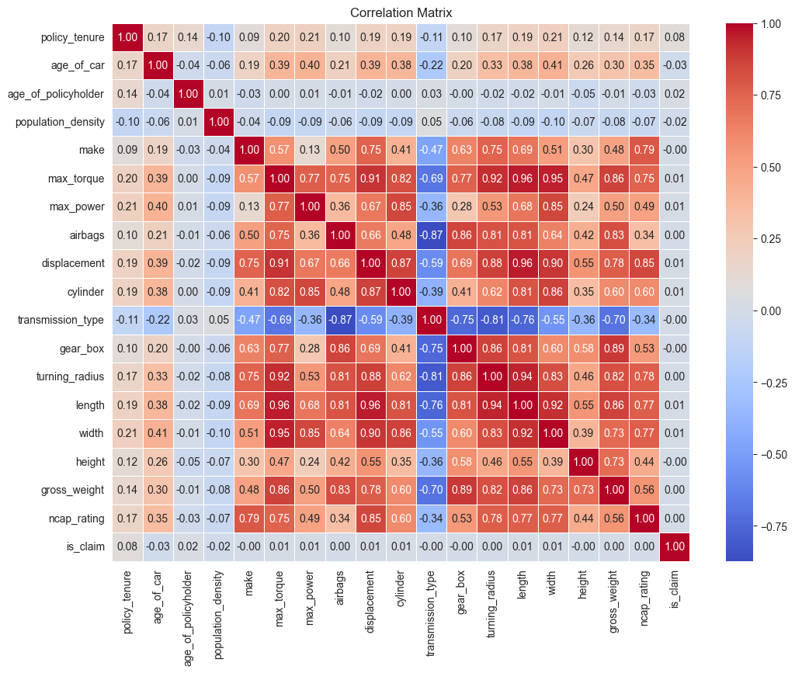
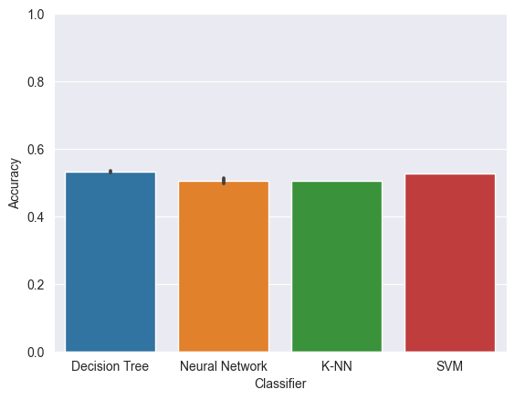
Implementation work already carried out
Data preprocess
Correlation analysis
Feature selection (based on correlation results)
Initial algorithm comparison

